Slide 1

Salesforce Implementation

Slide 2
Background
The Principals Academy Trust (PAT) was established in 2012 with the aim of improving educational outcomes for learners in state schools in marginalised communities
PAT Theory of Change focuses on empowering the principals who lead the schools, creating a trickle down effect that ultimately produces better academic results for learners
Over the past 10 years, PAT programme has included over 200 schools and touched the lives of over 200 000 learners
PAT operations team have accumulated significant amounts of school-related data which is used to track performance, derive insights and provide progress updates to funders
PAT operations team are now looking for a system to help better manage their data and internal processes to:
  Reduce manual effort, thereby creating additional hours for more meaningful work
  Provide better insights and reporting to help adapt PAT strategy and drive increased funder engagement
  Reduce human error
  Enable PAT to scale beyond the 200+ schools currently enrolled
  Create a single source of truth for all PAT data
To this end, PAT have requested Open Box Software’s assistance to implement a Salesforce solution

Slide 3
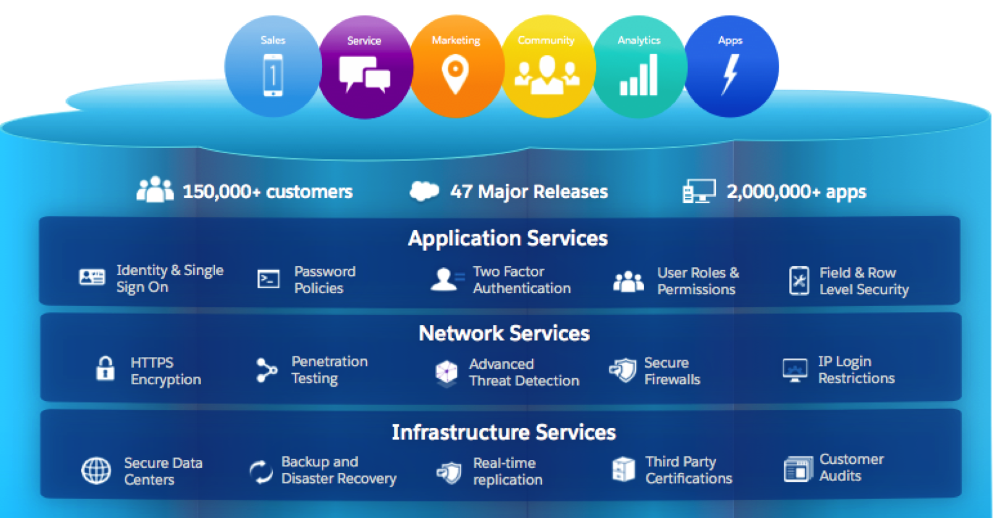
The Salesforce Platform Advantage
Salesforce lets companies have all customer data together in one place. It is a cloud-based platform that provides extensive out of the box functionality and is easy to customize and upgrade without anything breaking. Low level IT functionality (security, authentication, disaster recovery etc.) is all taken care of and you are empowered to spend your time building new capabilities and adding business value.
For PAT, Salesforce will become the single, secure, and scalable platform that holds all your data - school information, principal details, course marks, funders and their contributions and so much more….

Slide 4
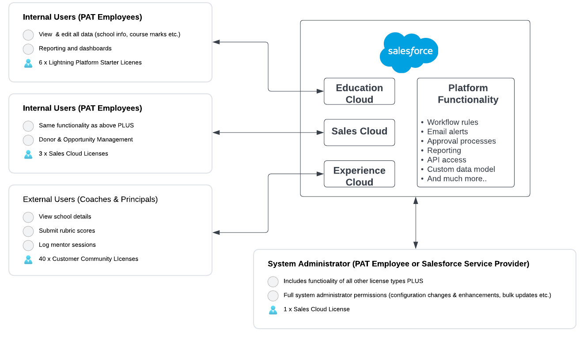
The Salesforce Solution for PAT
The proposed Salesforce solution for PAT shown on this slide uses a number of different “Clouds” (which can be described as functional modules that run on the Salesforce platform)
Education Cloud provides a data model and functionality to manage the operations of an entire school or university – i.e. it provides a system to to administer everything from student applications, onboarding, course enrolment, class attendance, test results and more. While PAT doesn’t require the ability to track data at a student level, Education Cloud functionality covers many of the data entities that Principals Academy Trust is already tracking and will give the ability to track academic programs available at a given school, course teachers, department heads, term dates etc
Sales Cloud empowers your sales team to track and monitor every funder's journey from start to finish in one place. Use automation and sales management tools to fundraise more efficiently so you can focus on delivering a great funder experience and closing more deals.
Experience Cloud is a configurable portal where external users (coaches, principals, funders) can login to interact with data limited to their specific roles. e.g. coaches can submit new rubric scores and log mentor sessions and can also view their past submissions.
Platform Functionality sits underneath everything, giving you the ability to automate, extend and enhance the business processes implemented within any of the Salesforce clouds.

Slide 5
Costing
Salesforce Annual License Fees – Indicative Costing
Salesforce is a SaaS solution (priced in USD) priced per user per month, normally paid annually. PAT will purchase licenses directly from Salesforce and may be able to negotiate more favourable pricing depending on license numbers and length of contract. Open Box Software will assist with recommendations on license types and volumes, but the final pricing and contract conditions will be agreed directly between Salesforce and PAT.
The indicative costing below is based on the user numbers as understood from discussions with PAT team. The costing is discounted because of PAT’s non profit status – for example the list price of Sales Cloud licenses is $150/user/month vs. $105 below. Further discounts may be possible pending negotiations with Salesforce.
License Type | Description | Monthly cost (USD/user/month) | Qty | Yearly Cost (USD)
Sales Cloud License | Full license used for admin and access to Sales Cloud for fundraising activities | $105 | 4 | $5,040
Lightning Platform Starter | Reduced functionality license used to access Education Cloud data (i.e. internal users who require access to everything except fundraising functionality) | $17.5 | 6 | $1,260
Customer Community Plus | License for external users to view and enter data via the "community cloud" portal | $9.75 | 40 | $4,680
 |  | TOTAL PER YEAR (USD) |  | $10,980
Notes:
Note: the above pricing is indicative only. Final pricing will be agreed contractually between Salesforce and Principals Academy Trust

Slide 6
Costing
Open Box Once Off Implementation Fees
Role | Rate (ZAR) | HOURS | TOTAL COST (ZAR)
Salesforce Architect | R 2,805 | 45 | R -
Salesforce Consultant | R 1,870 | 200 | R 374,000
Quality Assurance Tester | R 850 | 40 | R 34,000
Data Migration Specialist | R 850 | 50 | R 42,500
 | TOTAL | 335 | R 450,500
Open Box Software will be responsible for setting up a new Salesforce org and customising it to PAT’s requirements. The key activities involved in this implementation are detailed as below
  Analysis
    Requirements gathering, backlog creation
    High level solution design
  Build
    Customisation (adjusting the data model, adding workflows, page layouts etc.)
    Data migration (i.e. loading historical data)
    Training, testing and deployment
  Go Live Support
    Technical support for issues raised within the first 2 weeks after go-live
Notes:
Salesforce Architect hours are not being charged for (R126K)
Go live support to be handled under ongoing support

Slide 7
Design
Build
Rollout
Support & Enhance
Costing
Open Box 6 Month Support Transition Plan
The Salesforce platform requires ongoing support by a person/team who is proficient in Salesforce administration. This is needed to cover basic system support (e.g. user login / password reset issues, resolving data issues, assisting with end user questions etc.), but also extends to implementing minor enhancements and adding new functionality. This level of support is required in order to get a return on the investment made in the Salesforce platform.
With sufficient time and training, it is feasible (and desirable) that PAT take on this role internally. Open Box Software strongly advise that PAT consider a transition plan where Open Box Software will provide support and help to skill up PAT team to ensure maximum efficiency and adoption of the new system.
Open Box Software will provide 20 hours / month support for a period of six months. During this time, the support hours will be used to handle basic Salesforce support and administration tasks, working closely with the PAT team to ensure knowledge transfer and upskilling so that Principals Academy Trust team are able to take over the support of their Salesforce org at the end of the six month period.
Open Box Software are able to offer Salesforce Administrator Support to PAT at a reduced rate of ZAR850/hour, i.e. For a monthly allocation of 20 hours’ support work, Open Box Software will bill an amount of ZAR17 000/month. (Please note that unused hours at the end of the month will not roll over into the next month)
Notes:
The post-go live support would be included in this support plan as we haven’t charged for it separately in the implementation
These hours would also be used to assist PAT with data migration of historical performance data

Slide 8
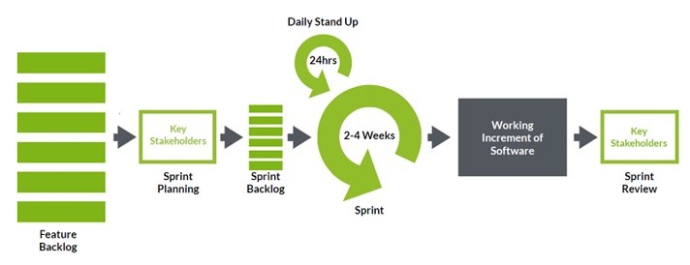
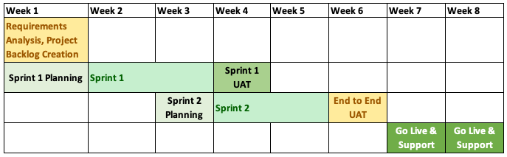
Project Delivery and Timelines
Delivery Methodology
Open Box Software deliver using a SCRUM Agile methodology where features are developed in 2 week sprints
After each sprint, the new features are reviewed and tested by PAT. This gives PAT the ability to provide feedback based on their experience of a working system, allowing the team to iterate quickly and make changes if required.
The Agile methodology prioritises collaboration over documentation and focuses on delivering working software for a fixed cost within a fixed time frame - thus mitigating the risks of scope creep, delays and the associated cost increases.
Timelines
Based on the requirements discussed with PAT team, Open Box Software are confident that a working version can be delivered within two sprints as per the timeline shown.
The timeline is very short in order to keep costs down. The feature backlog will be carefully prioritised to ensure that delivery effort is expended on functionality that provides maximum benefit to PAT.
It’s important to understand that innovation doesn’t stop after week 8 – as PAT team skill up, they will be able to leverage the power of the Salesforce platform to implement new features and processes on an ongoing basis.
Notes:
Go live support to be handled under ongoing support

Slide 9
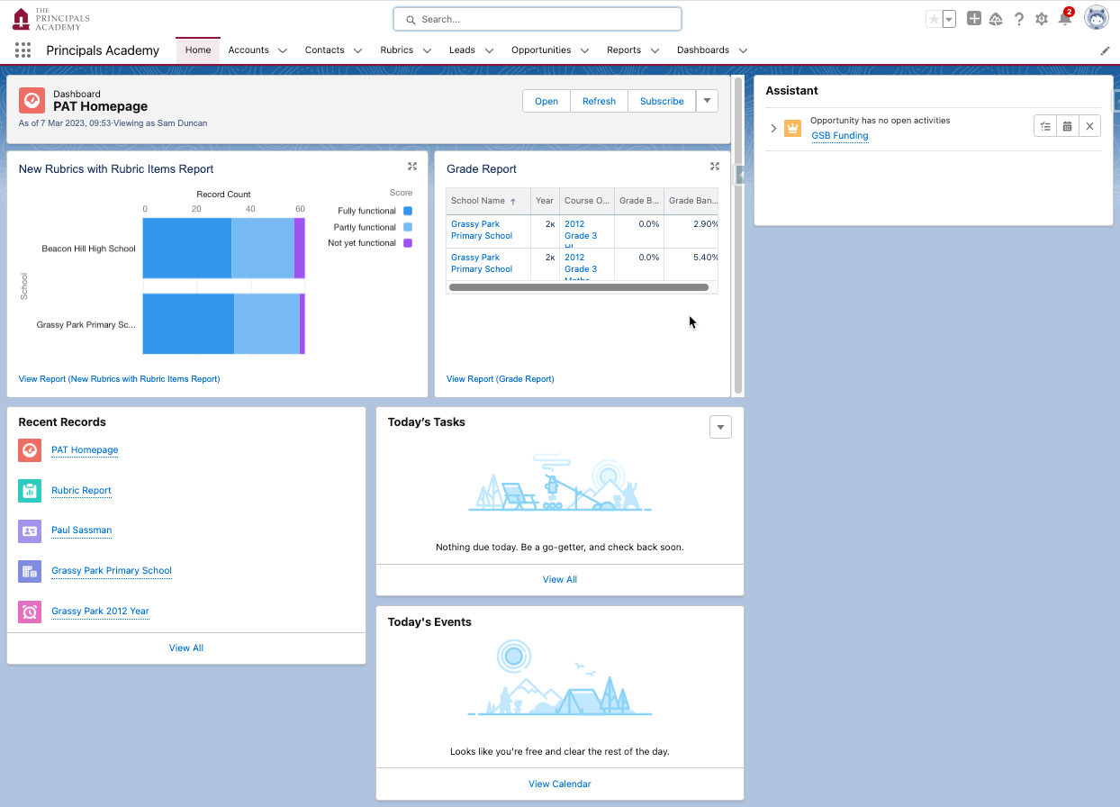
Education Cloud Demo
In order to illustrate what a Salesforce solution would look like, a demo has been configured and presented to the PAT team. The demo is intended to give PAT a tangible idea of how Salesforce works and also to understand the speed and agility with which new functionality can be delivered.

Slide 10
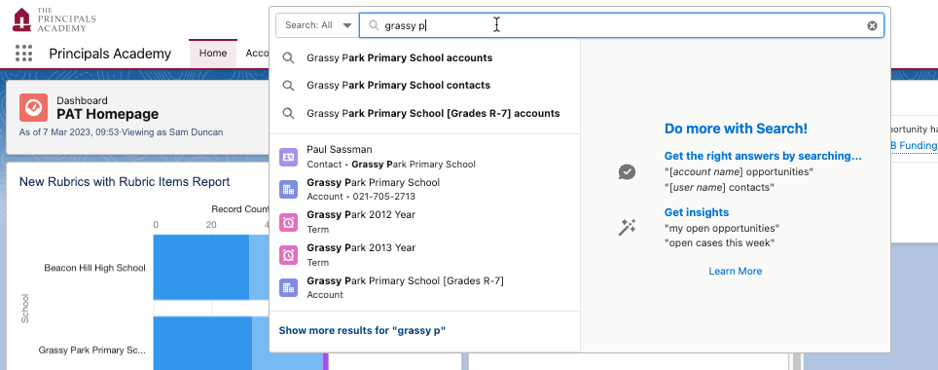
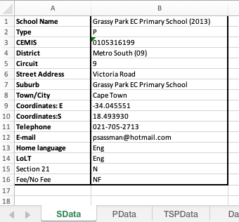
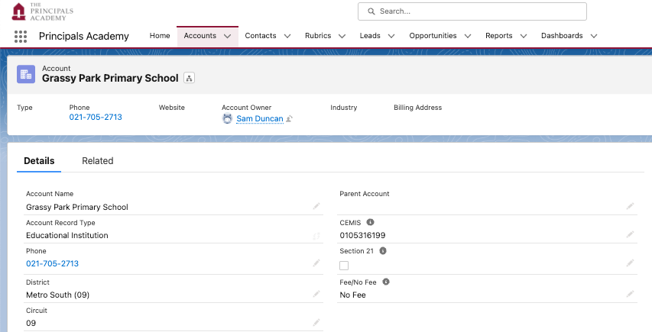
Education Cloud Demo
Searchable database to easily find schools, principals, funders etc.
School Details
Current State
School details are stored in a spreadsheet, 1 spreadsheet per school (200+ spreadsheets in total)
Future State
Robust data model to hold all school information and share/collaborate with other PAT users
PAT-specific details captured on each record

Slide 11
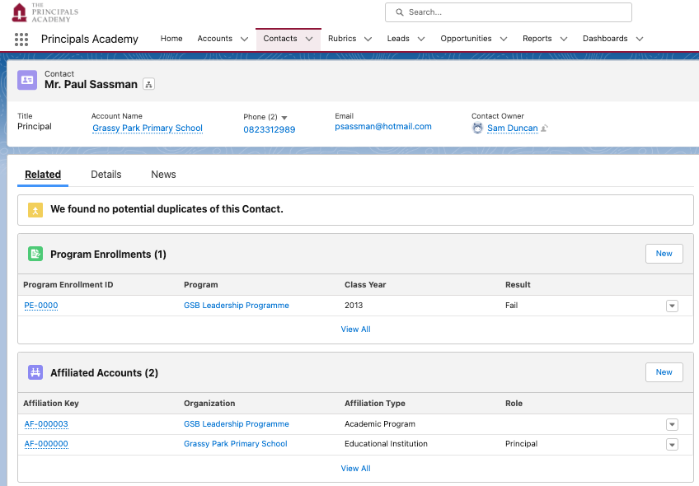
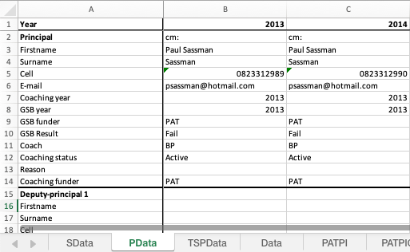
Education Cloud Demo
Principal Details
Principal details are stored in Salesforce, searchable and visible to other PAT users
Related information easily tracked and visible – e.g. GSB enrolments, roles held at different schools over time etc.
Current State
Principal details are maintained in a spreadsheet, 1 spreadsheet per school (200+ spreadsheets in total)
Principal’s personal details
Future State
GSB enrollments
Tenure at various schools over time

Slide 12
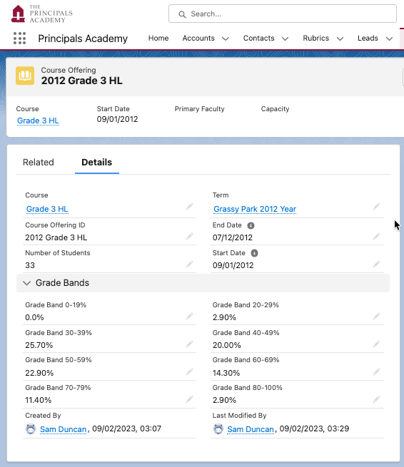
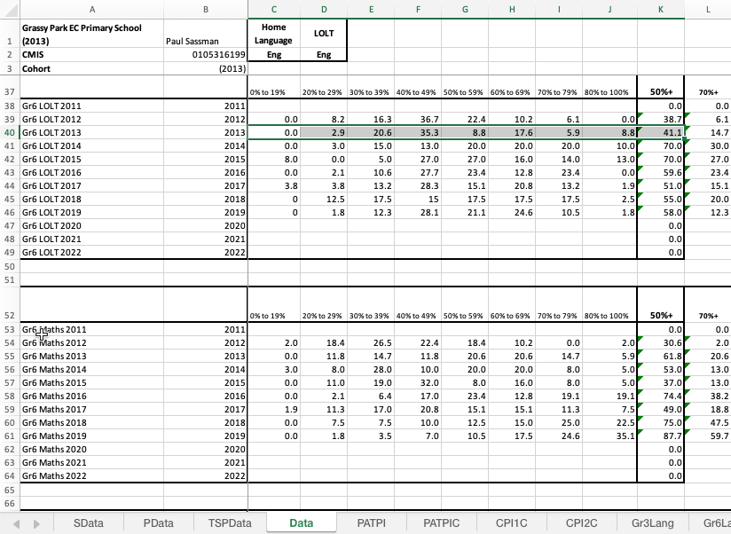
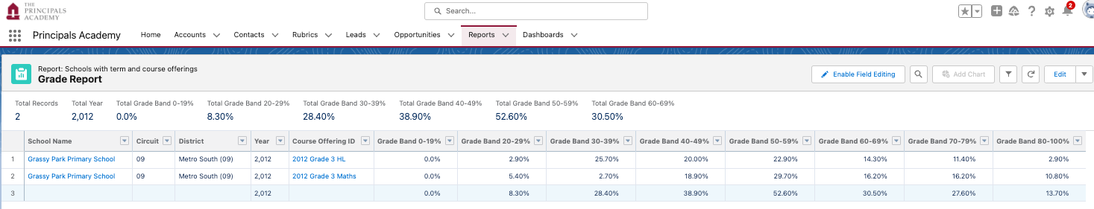
Education Cloud Demo
Grade Results & Reporting
Future State
Grades are captured in Salesforce against each class
Validation rules to prevent data entry errors
Formulae to automatically calculate key metrics
Current State
Grade reports are maintained in a spreadsheet per school (200+ spreadsheets in total)
Reporting engine can aggregate data across multiple schools, years and classes

Slide 13
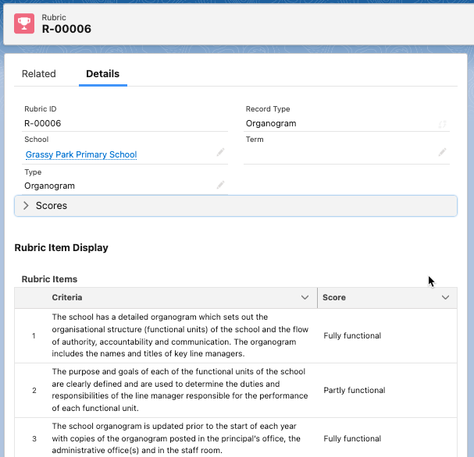
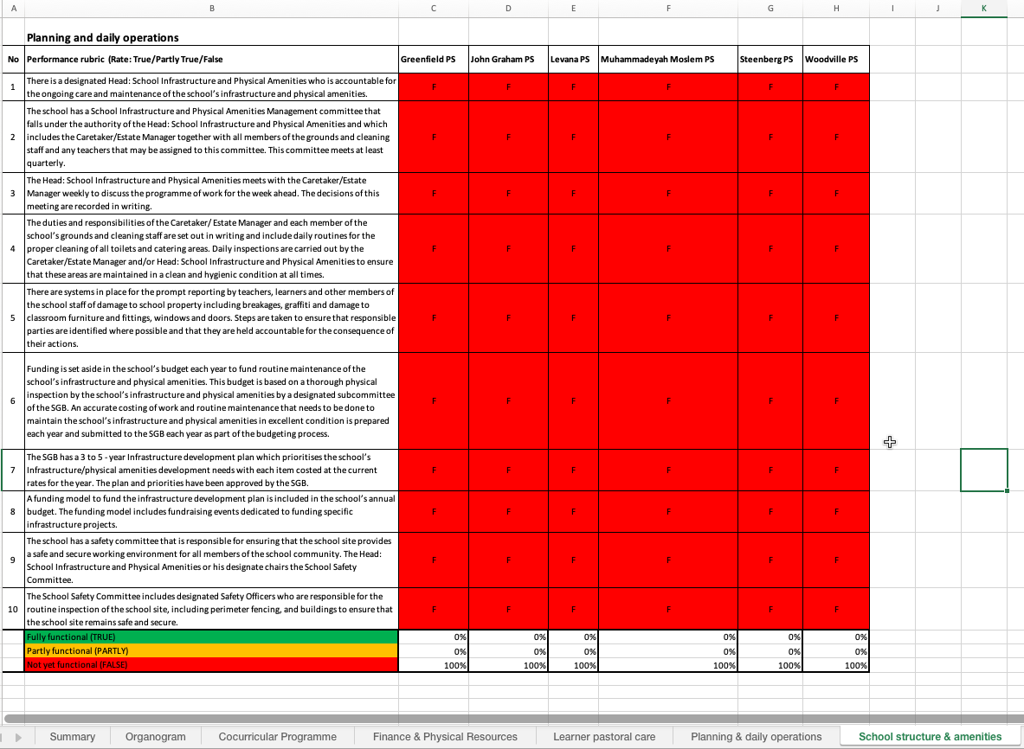
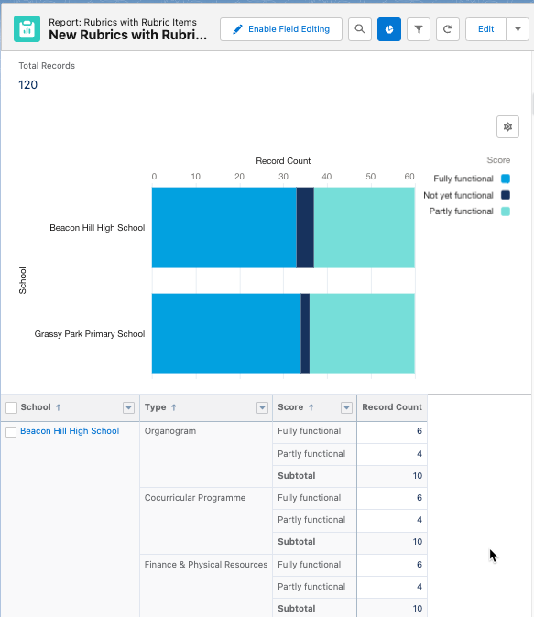
Education Cloud Demo
Rubric
Rubrics scores are entered by coaches directly into Salesforce via Experience Cloud (portal)
Future State
Current State
Rubrics captured by coaches in spreadsheets, 1 spreadsheet per coach, multiple schools in each spreadsheet
Reporting engine can aggregate rubric data across multiple schools, years and classes
Key metrics from reports can be exposed on charts and dashboards and shared with all PAT users

Slide 14
Questions

Slide 15
The Salesforce Solution
Salesforce is a Platform as a Service (PaaS) solution Platform is a P
lets companies have all customer data together in one place. This means companies can take full advantage of wherever the next generation of technology takes your customers and business.
The Salesforce Platform lets companies have all customer data together in one place. This means companies can take full advantage of wherever the next generation of technology takes your customers and business.

